Slide 1

NAMAN AGARWAL – E23CSEU1884
ARYAN VARSHNEY – E23CSEU1911

Slide 2


Slide 3
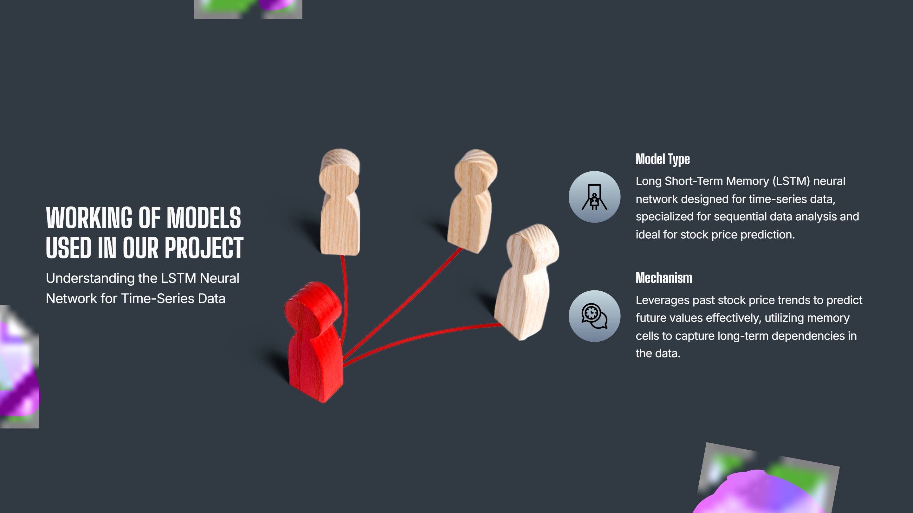

Slide 4
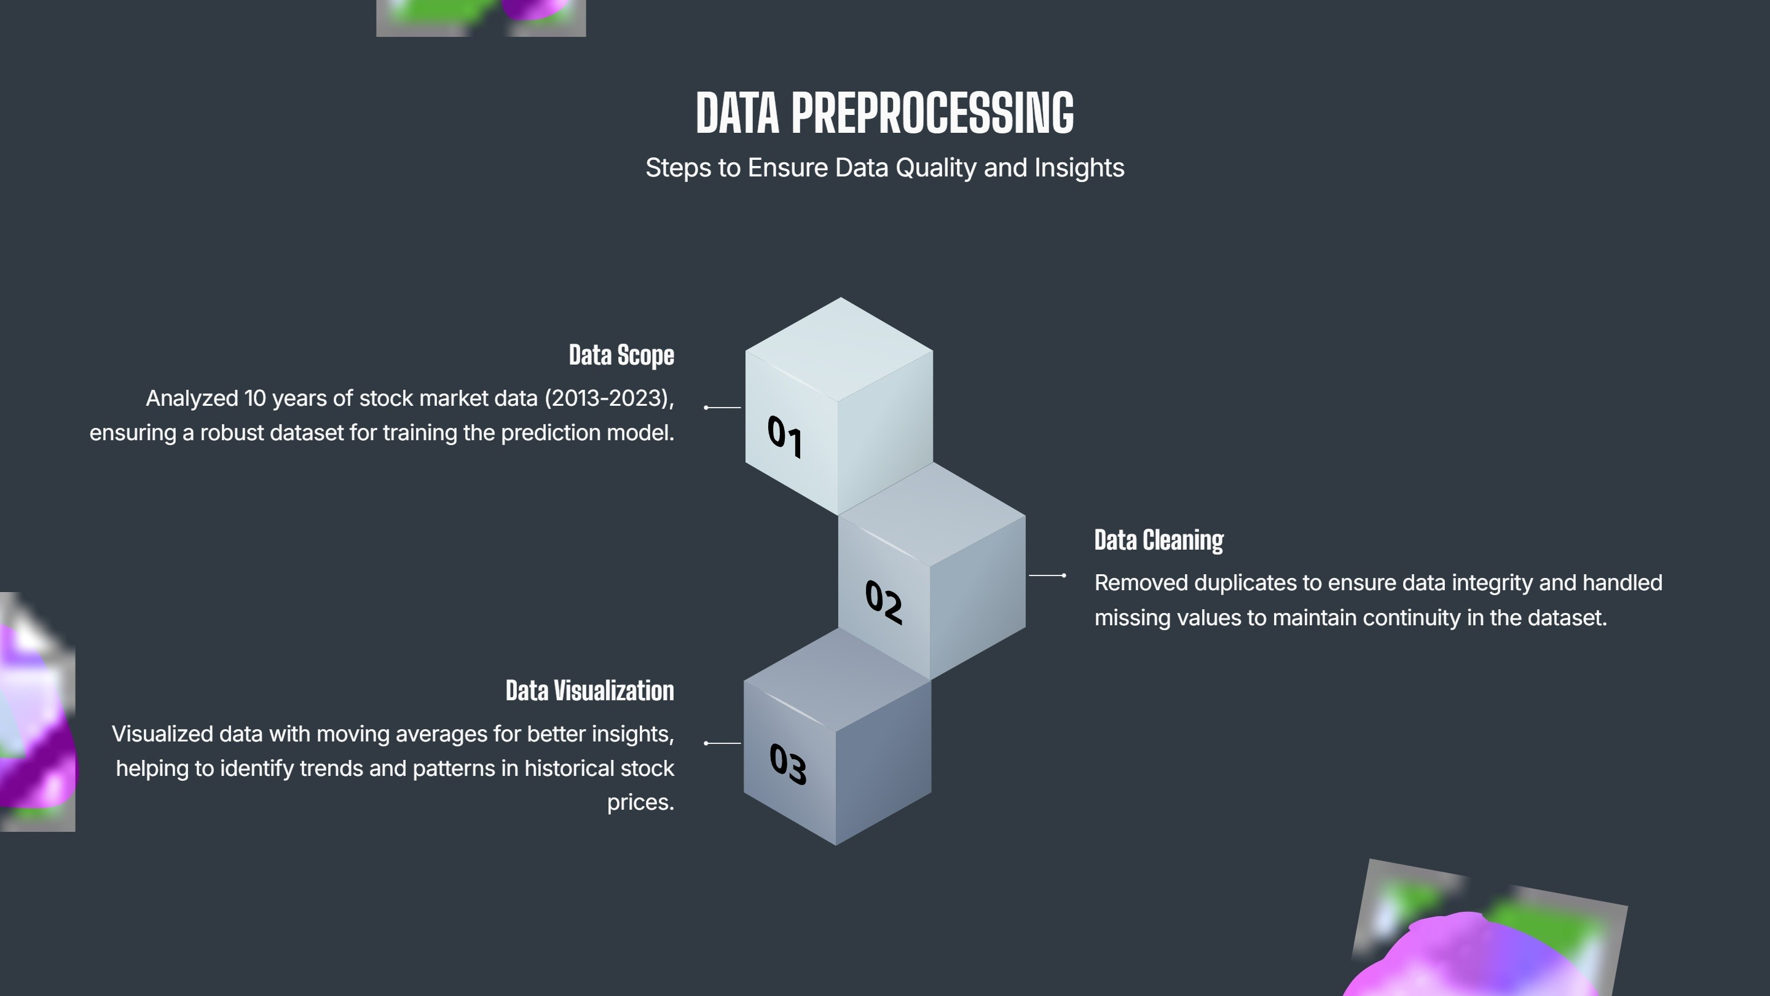

Slide 5
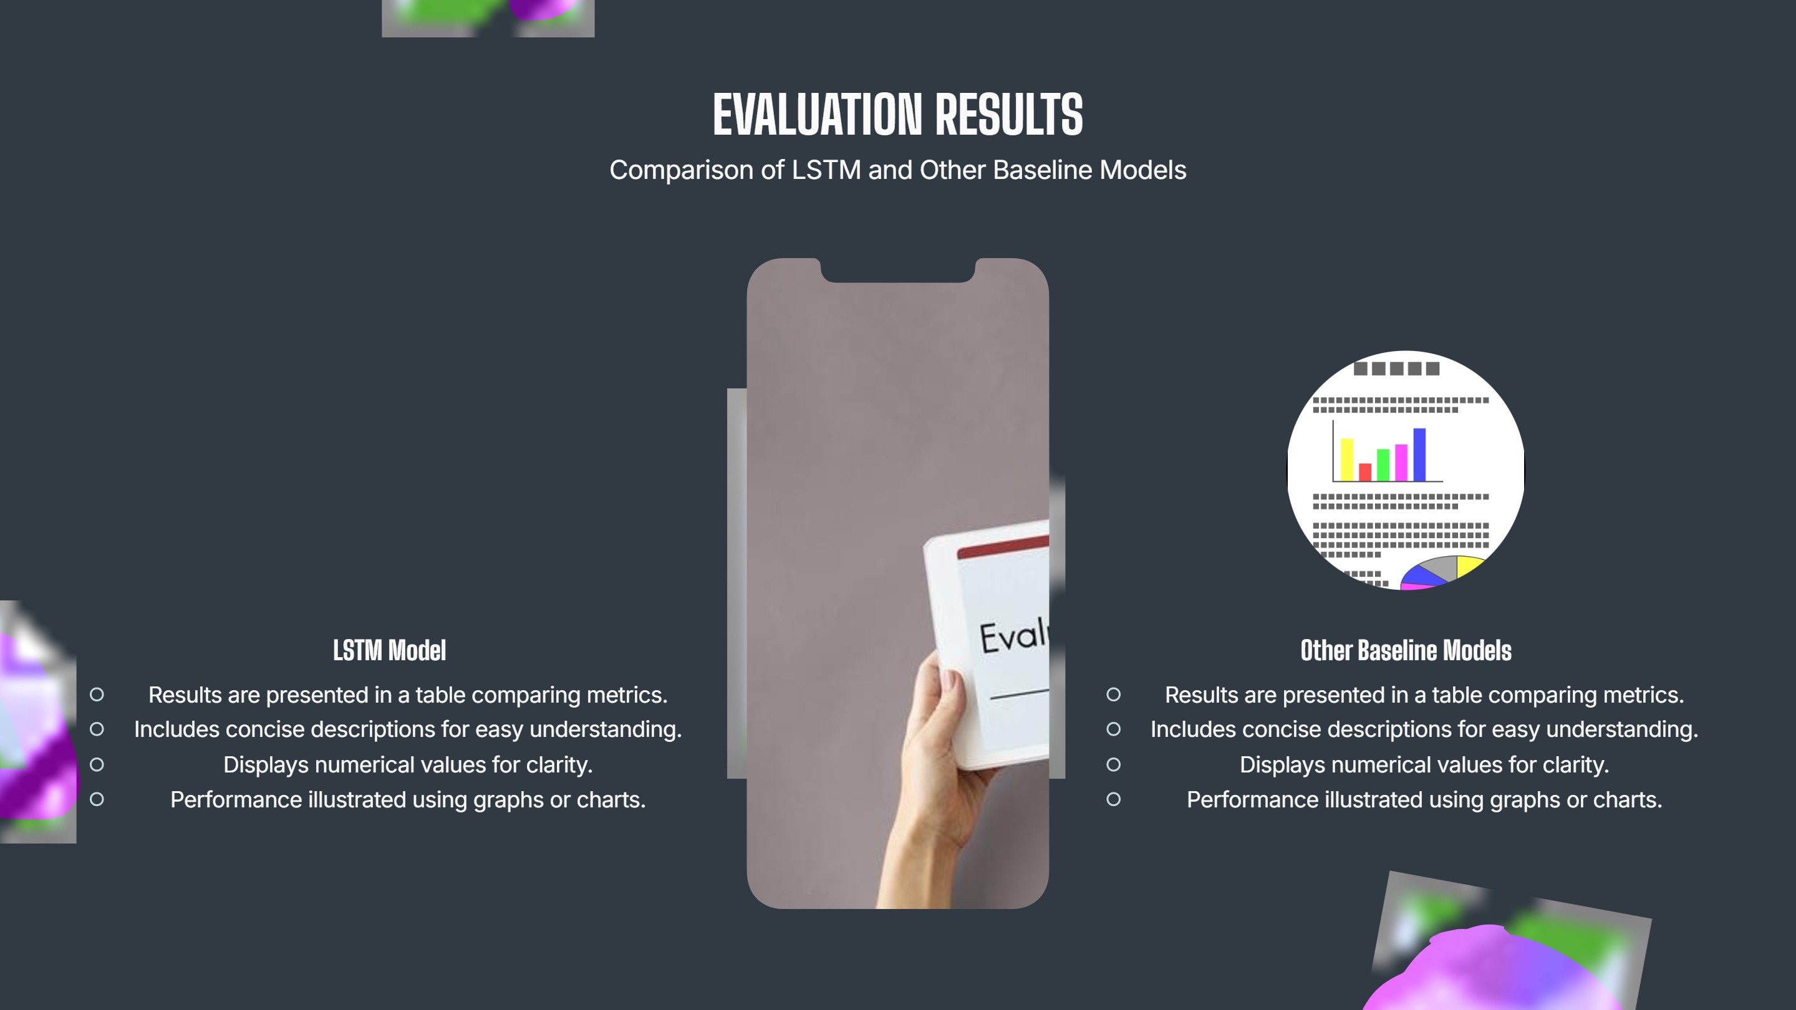

Slide 6


Slide 7


Slide 8


Slide 9
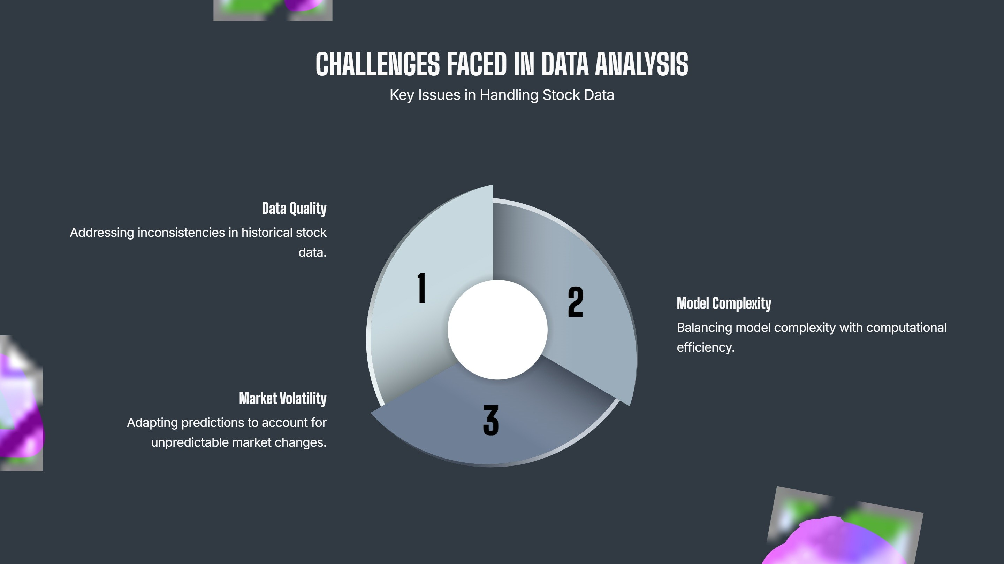

Slide 10


Slide 11


